Slide 1
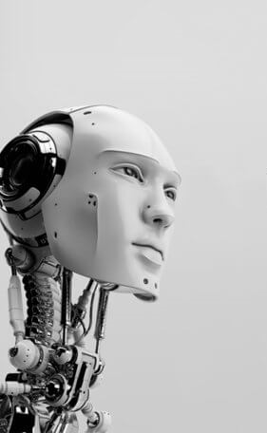
Artificial Intelligence
Course Code: CSE-403
3.00 Credit hr.
Introduction

Slide 2
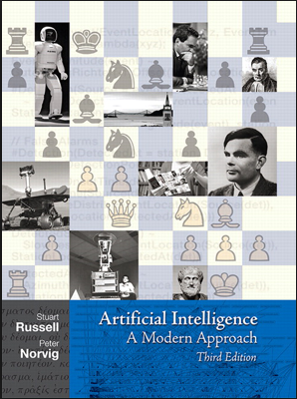
Artificial Intelligence
Text Book:
Russell & Norvig, AI: A Modern Approach, 3rd Ed.
Schedule: 403A
Sunday, 1000-1055
MONDAY 1155-1340
Schedule: 403B
Sunday, 1145-1240
WEDNESDAY, 0800-0855
THURSDAY, 0800-0855

Slide 3
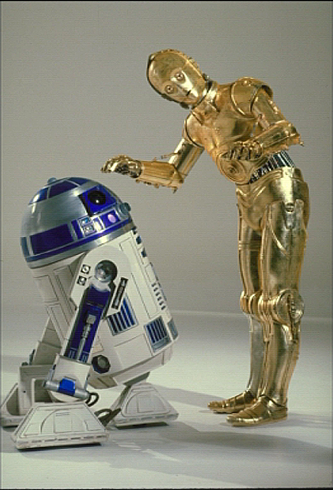

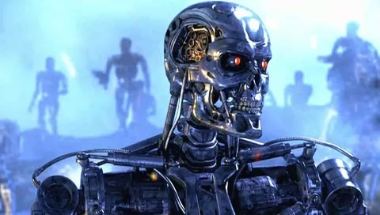


Sci-Fi AI?
Notes:
Star Wars
Battlestar Galactica: The Plan

Slide 4
Foundation of AI:
Philosophers
Mathematicians
Economists
Neuroscience
Psychology
Computer Engineers
Control Theory

Slide 5

Artificial
Made or produced by human beings rather than occurring naturally, especially as a copy of something natural.

Slide 6

Intelligence
Knowledge
Intelligence
Reasoning
Think
Plan
Solve Problem
Understand ideas
Learn and act accordingly

Slide 7
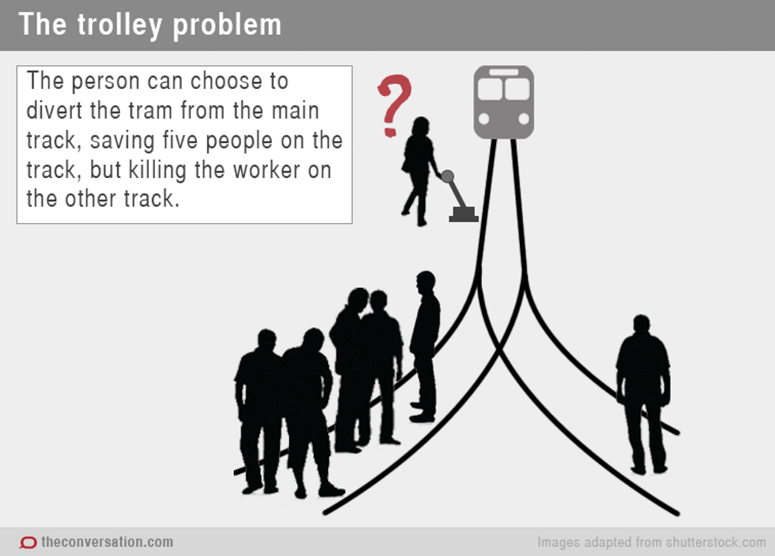
FRIENDS
WORKER

Slide 8

HUMAN INTELLIGENCE INVOLVES RATIONALITY AND ETHICS

Slide 9
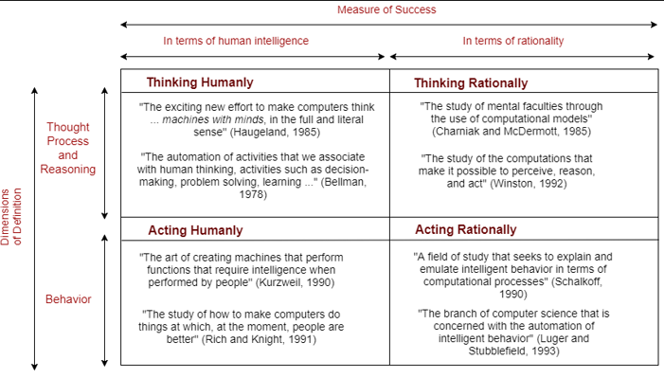
Definition of Artificial Intelligence

Slide 10
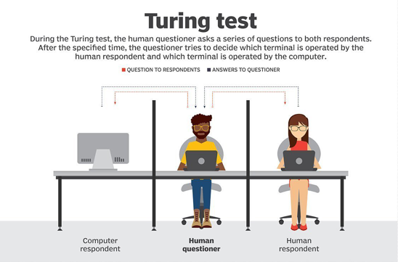
Definition of Artificial Intelligence: Acting Humanly
Proposed by Alan Turing (1950)
To provide a satisfactory operational definition of intelligence

Slide 11
Definition of Artificial Intelligence: Acting Humanly(…)
Natural Language Processing (NLP) is to enable to communicate successfully in English.
Knowledge Representation to stores what is knows or hears.
Automated Reasoning to use the stored information to answer questions and to draw new conclusions
Machine Learning to adapt to new circumstances
Computer Vision to perceive objects
Robotics to manipulate objects and move about

Slide 12
Definition of Artificial Intelligence:
Thinking Humanly
Cognitive Modeling Approach: Based on workings of human mind
the study of thought, learning, and mental organization, which draws on aspects of psychology, linguistics, philosophy, and computer modelling.
Thinking Rationally
Laws of Thought: Based on logic and correct inference
Acting Rationally
The Rational Agent Approach- acting in a way to achieve the best result

Slide 13
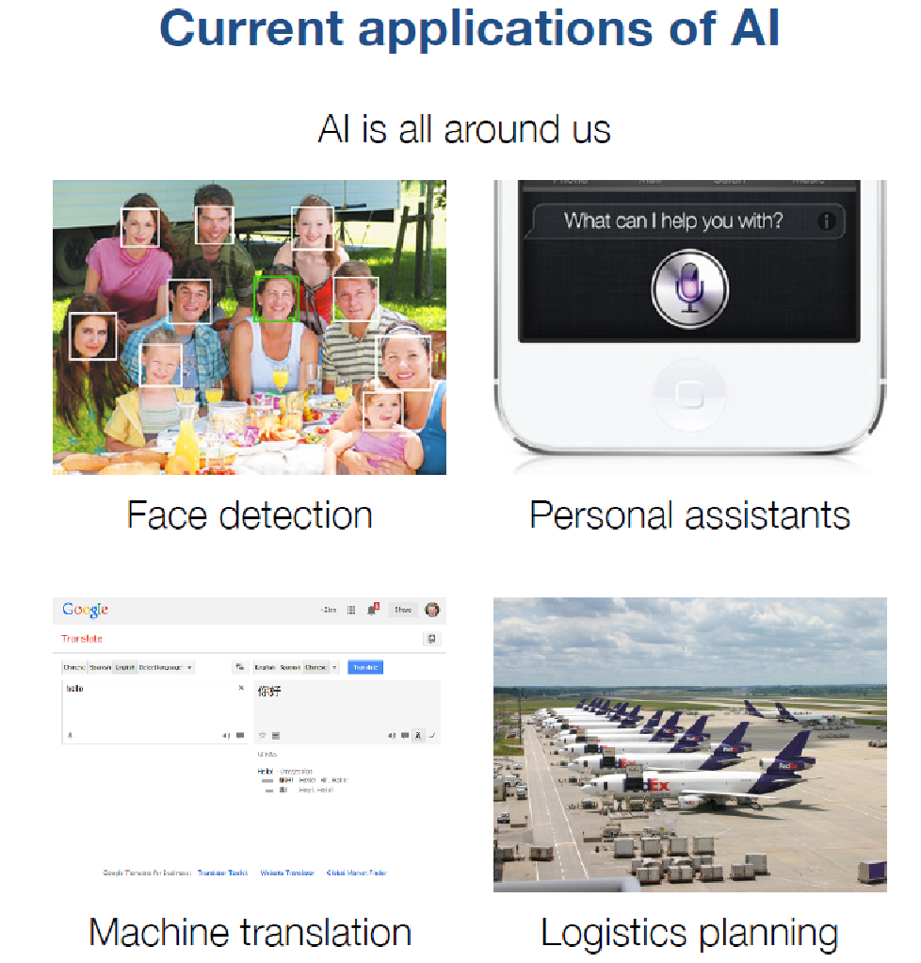
Application of AI:
Autonomous Planning and scheduling (spacecraft)
Game Playing
Autonomous Control (Car)
Diagnosis (medical)
Logistic Planning (transportation)
Robotics
Language Understanding and problem solving
Notes:
DARPA = Defense Advanced Research Project Agency

Slide 14
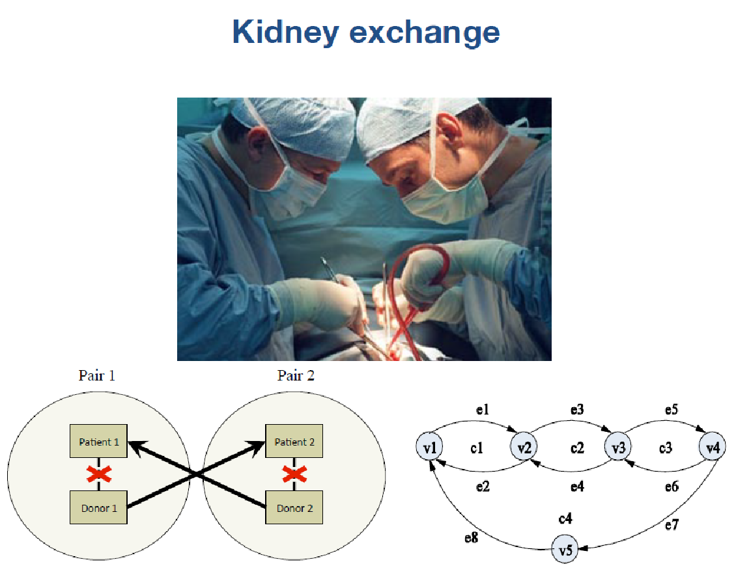
Application of AI:

Slide 15
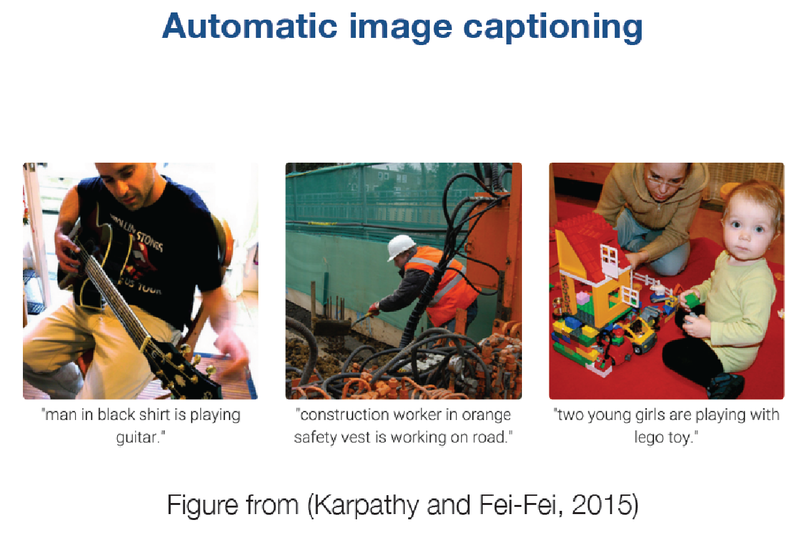
Application of AI:

Slide 16
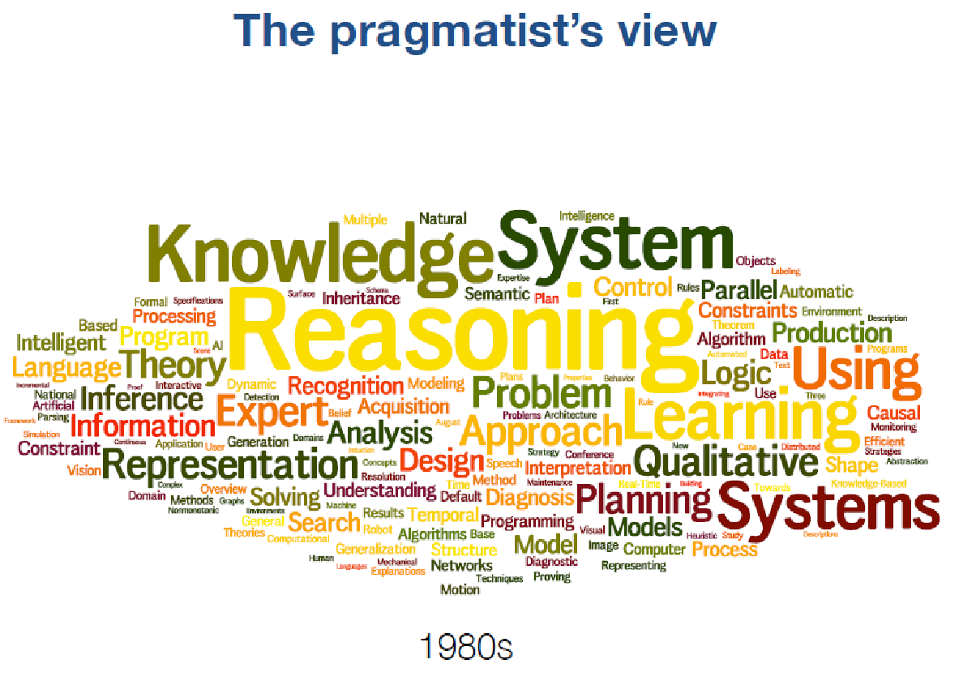

Slide 17
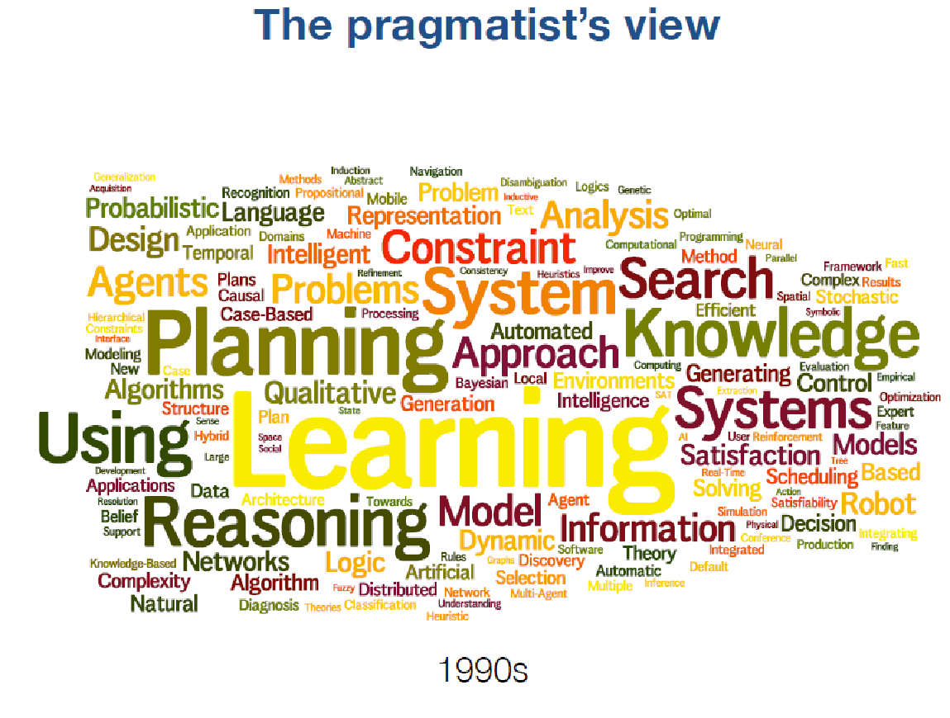

Slide 18
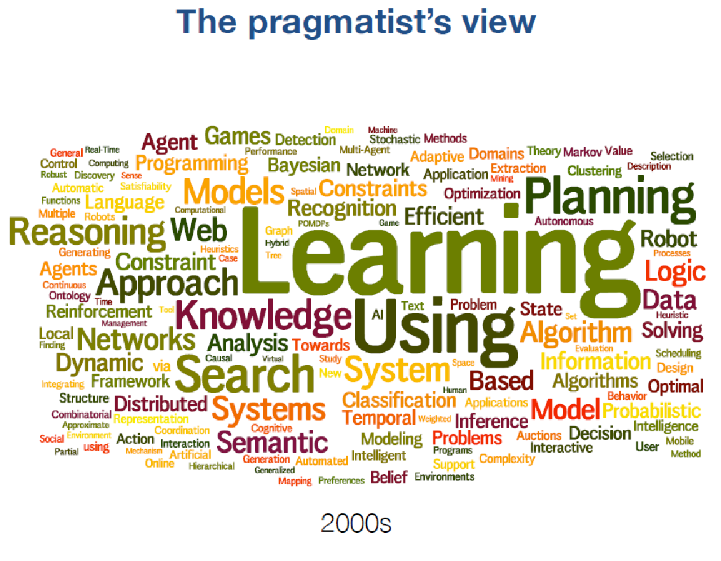

Slide 19
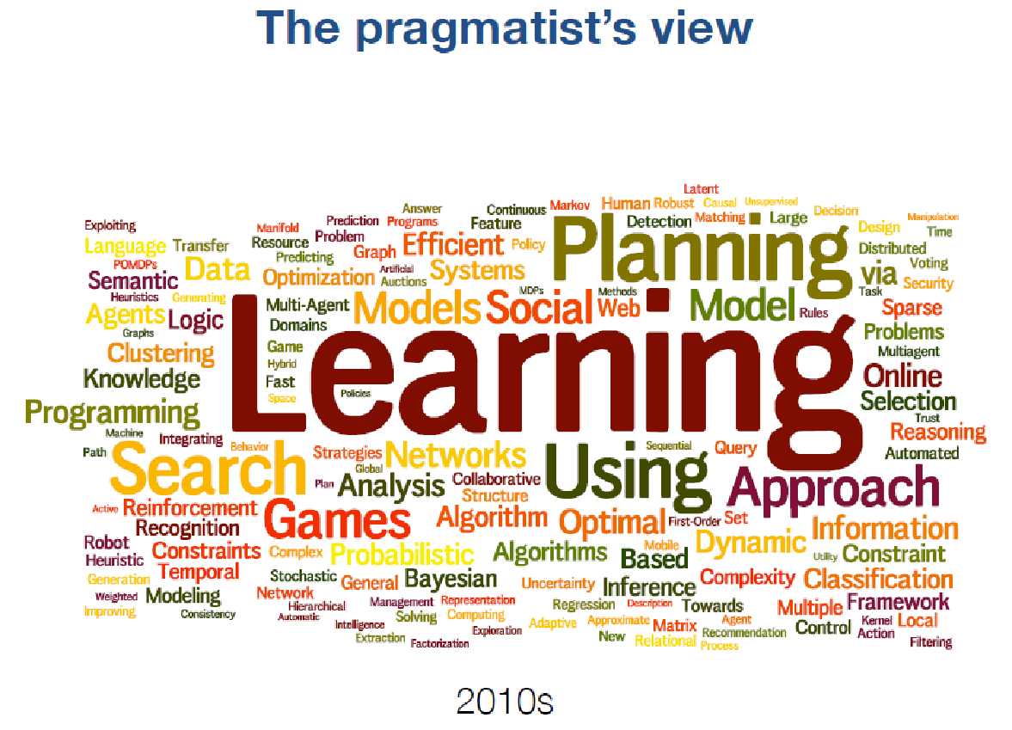

Slide 20

What Can AI Do?
Quiz: Which of the following can be done at present?
Play a decent game of table tennis?
Play a decent game of Jeopardy?
Drive safely along a curving mountain road?
Drive safely along Telegraph Avenue?
Buy a week's worth of groceries on the web?
Buy a week's worth of groceries at Berkeley Bowl?
Discover and prove a new mathematical theorem?
Converse successfully with another person for an hour?
Perform a surgical operation?
Put away the dishes and fold the laundry?
Translate spoken Chinese into spoken English in real time?
Write an intentionally funny story?

Slide 21
Thank you ☺

